Slide 1
Consumption of ABAP CDS Views (part 1)

Slide 2
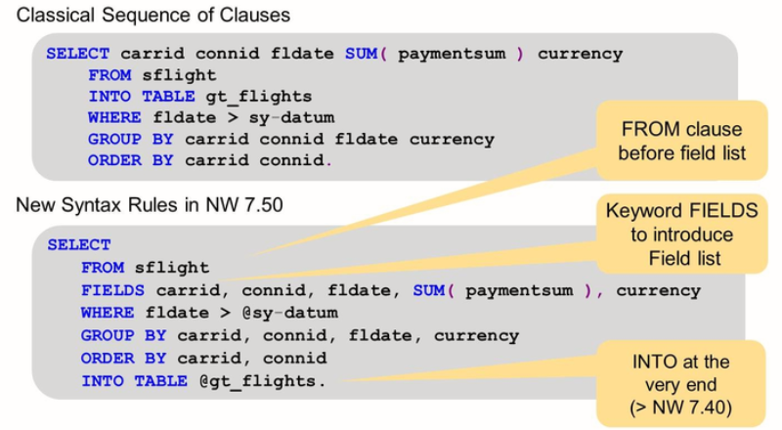
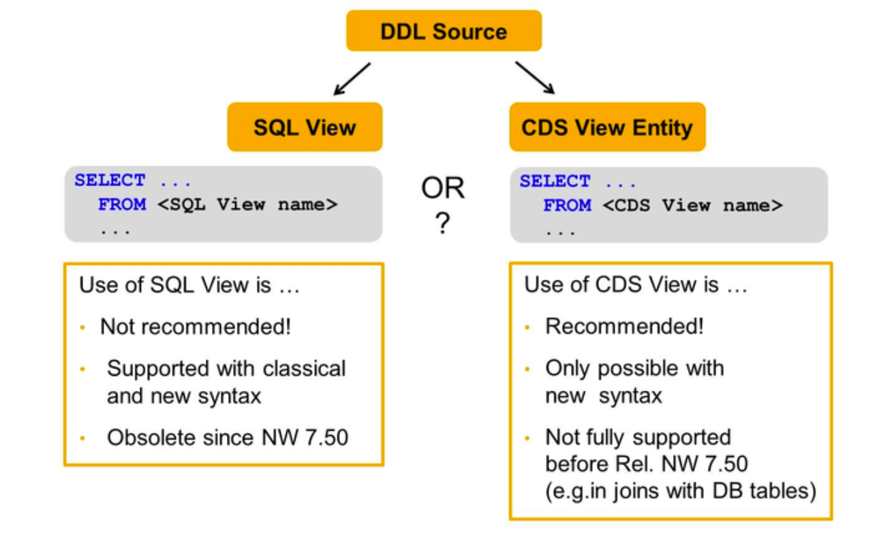
Open SQL Consumption of ABAP CDS Views (part 1)
Open SQL
Use the CDS View name not SQL View name
Notes:
Data Definitions เป็นโค้ด SQL ที่สุดท้ายแล้วพอ activate จะไปสร้าง HANA View

Slide 3
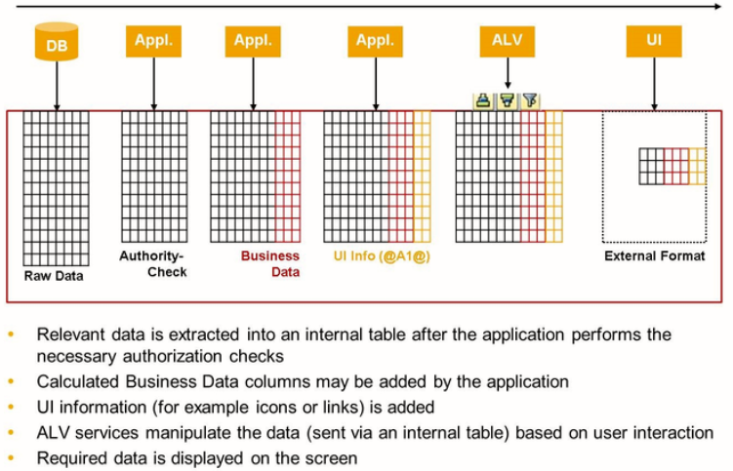
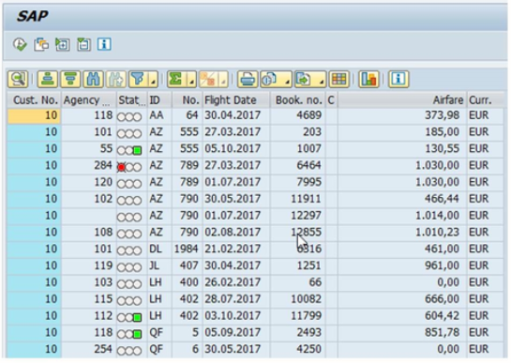
ALV IDA Consumption of ABAP CDS Views (part 1)
Classic ALV
Display/filter/sorting/grouping from Internal Table

Slide 4
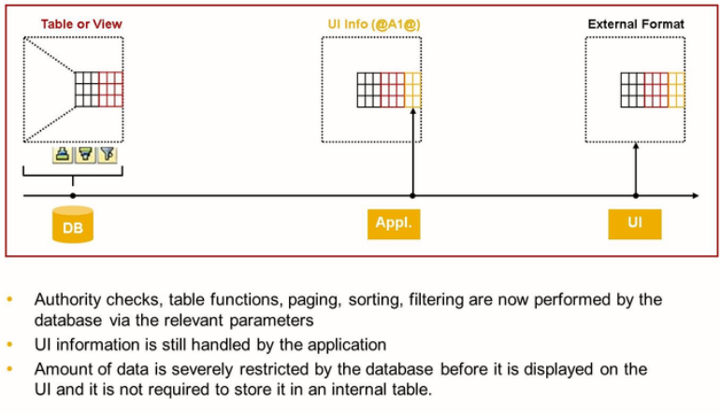
ALV IDA Consumption of ABAP CDS Views (part 1)
ALV IDA
Display/filter/sorting/grouping directly from DB

Slide 5
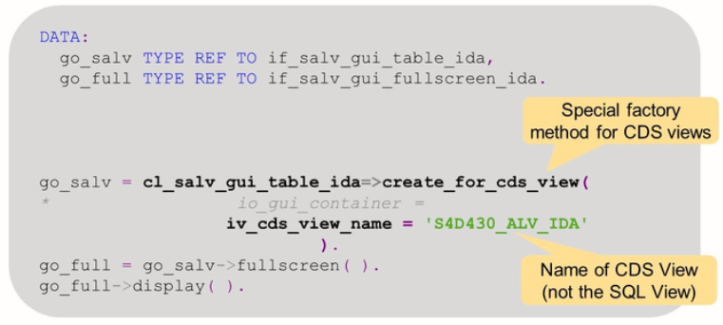
ALV IDA Consumption of ABAP CDS Views (part 1)
Class - CL_SALV_GUI_TABLE_IDA
Class CL_SALV_GUI_TABLE_IDA method CREATE_FOR_CDS_VIEW
See more sample program in package ‘SALV_IDA_TEST’

Slide 6
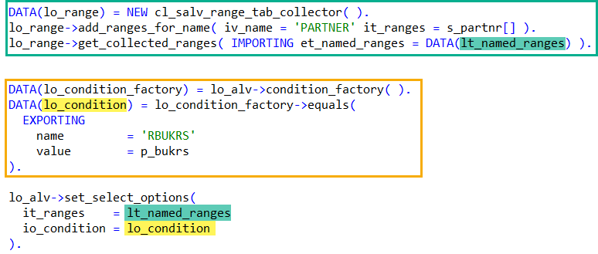
ALV IDA Consumption of ABAP CDS Views (part 1)
Select-Options (Range) / Parameters
Ranges
Helper class ‘CL_SALV_RANGE_TAB_COLLECTOR’
Parameters
Helper class ‘CL_SALV_IDA_CONDITION_FACTORY’

Slide 7
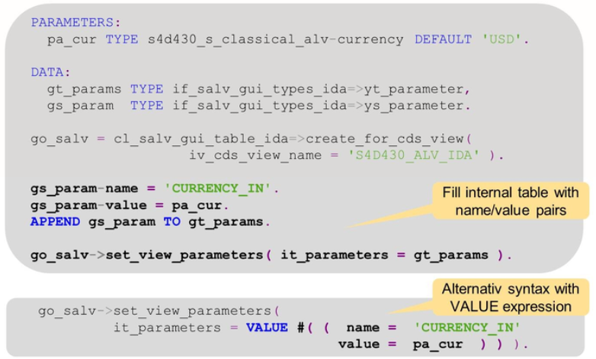
ALV IDA Consumption of ABAP CDS Views (part 1)
Input Parameters

Slide 8
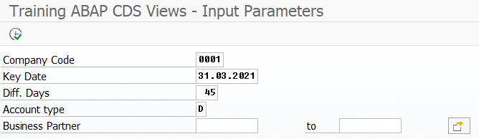
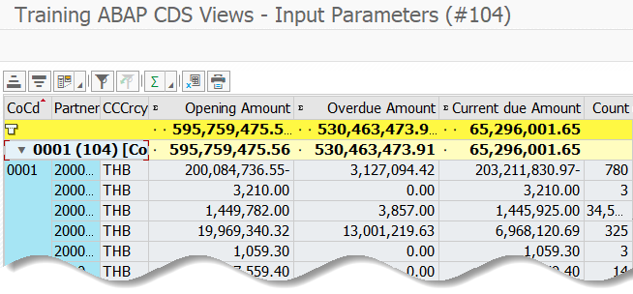
Exercise 15 – ALV IDA Consumption of ABAP CDS Views (part 1)
Exercise 15 – ALV IDA
Create program ‘ZTRAINXX_CDS_04’.
Selection-screen
P_BUKRS type BUKRS default ‘0001’
P_KEY_DAT type DATUM default ‘20210331’
P_DAYS_1 type INT1 default 45
P_KOART type KOART default ‘D’
S_PARTNR for BUT000-PARTNER
Consume
ZC_TRAINXX_ADVANCED_03
Display
Use CL_SALV_GUI_TABLE_IDA=>CREATE_FOR_CDS_VIEW
Group
RBUKRS
Aggregations
HSL SUM
OVERDUE SUM
CURRENTDUE SUM

Slide 9
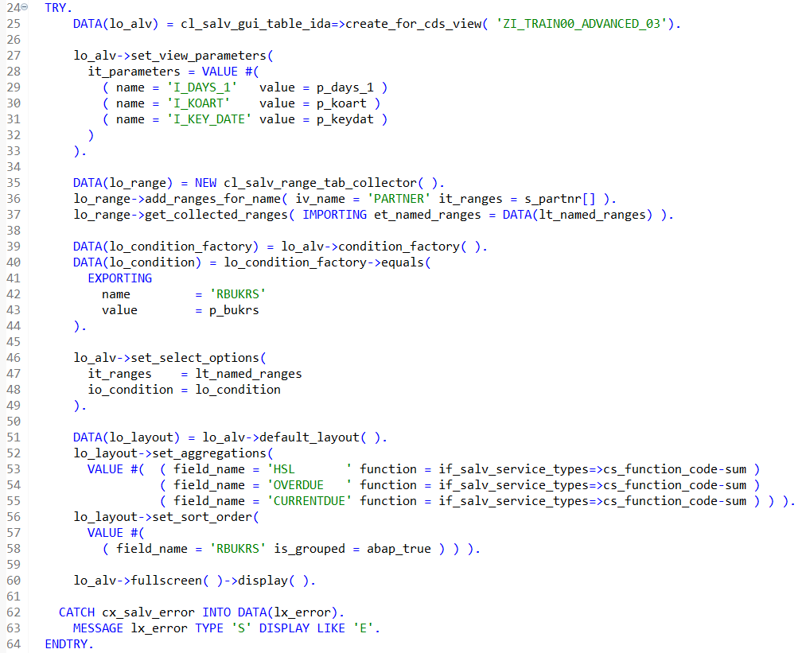
Exercise 15 – ALV IDA Consumption of ABAP CDS Views (part 1)
Write ABAP code

Slide 10
Exercise 15 – ALV IDA Consumption of ABAP CDS Views (part 1)
Prove Exercise 13 – Access Controls
Copy DDL ‘ZI_TRAIN00_MORE_06’ to ‘ZI_TRAINXX_MORE_06’
Modify DDL ‘ZP_TRAINXX_ADVANCED_03’
Change data-source from ‘ZI_TRAIN00_MORE_06’ to ‘ZI_TRAINXX_MORE_06’
Comment
// and ACC.RBUKRS = '0001’
Logon with this account (PFCG only allow BUKRS = ‘0001’)
Username TRAIN_W_AUTH
Password @llTrain2021
Client 110
Execute
Company ‘0024’
Check the result

Slide 11
Enhancing an ABAP CDS View

Slide 12
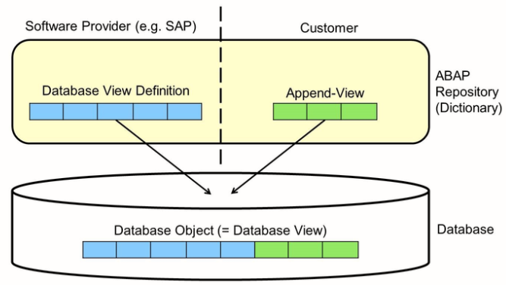
Classical Append Enhancing an ABAP CDS View
Append for Classical Database View

Slide 13
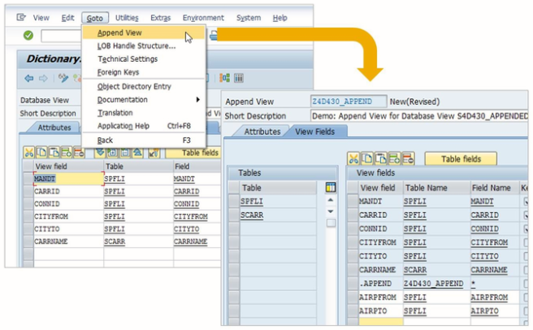
Classical Append Enhancing an ABAP CDS View
Append for Classical Database View

Slide 14
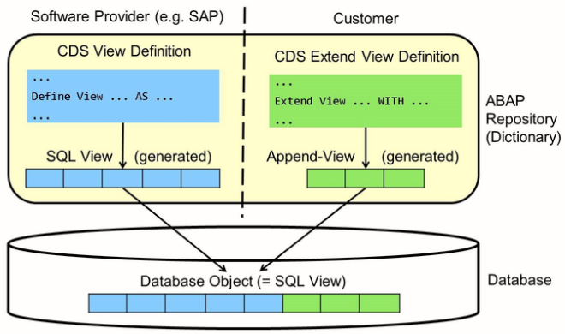
ABAP CDS View Extension Enhancing an ABAP CDS View
ABAP CDS View Extension
Defined in dedicated DDL Sources via DDL statement EXTEND VIEW.
Every DDL Source with a CDS view extension defines two objects:
The actual CDS view extension and an Append View.

Slide 15
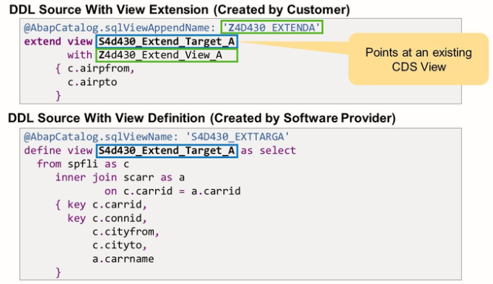
ABAP CDS View Extension Enhancing an ABAP CDS View
ABAP CDS View Extension
This corresponds to the two objects defined by a standard.
DDL: The CDS View and the SQL View.

Slide 16
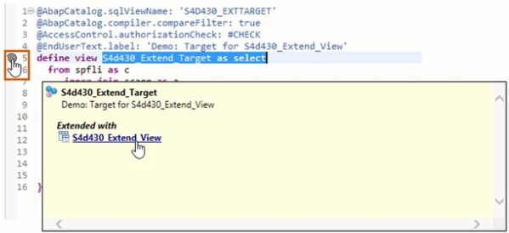
ABAP CDS View Extension Enhancing an ABAP CDS View
Navigation from Extension Target to View Extension
You can see it directly in the DDL Source if there are any extends for this CDS View.
If one or more CDS View Extends point to this CDS View, a spiral-shaped symbol appears on the left of the DEFINE VIEW Statement.
When you place the pointer over this symbol, a dialog box opens with a list of the existing extensions. Open the definition of the CDS View Extend by clicking on its name in the list.

Slide 17
Exercise 16 – Extend View Enhancing an ABAP CDS View
Exercise 16 – Extend View
Assume the ‘ZI_TRAINXX_ADVANCED_03’ and ‘ZC_TRAINXX_ADVANCED_03’ are the standard object.
Append ABAP CDS View ‘ZI_TRAINXX_ADVANCED_03’ by ‘ZX_TRAINXX_ADVANCED_03’
Append SQL View name: ‘ZXTRAINXXADVAN03’
Add relations to
ZI_TRAIN00_BASIC_01 as _Company
BUKRS = field RBUKRS
Add fields
FIXED_VAL Display fix value: 1
KEYDATE Display input parameter I_KEYDATE
Expose
_Company
Append ABAP CDS View ‘ZC_TRAINXX_ADVANCED_03’ by ‘ZXC_TRAINXX_ADVANCED_03’
Append SQL View name: ‘ZXTRAINXXADVA003’
Add fields
KEYDATE Display input parameter I_KEYDAT
BPGROUP _PARTNER.BUSINESSPARTNERGROUPING

Slide 18
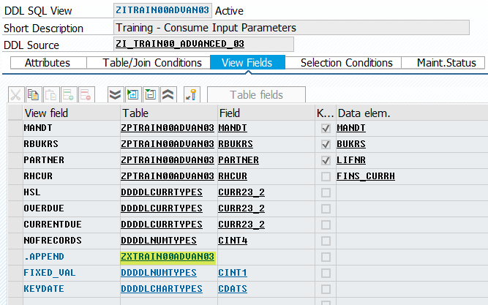
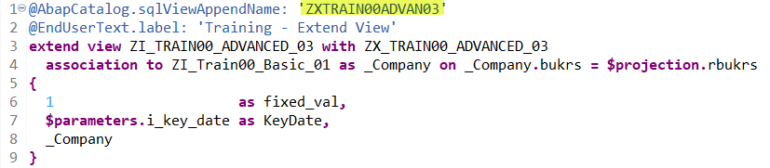
Exercise 16 – Extend View Enhancing an ABAP CDS View
ZX_TRAINXX_ADVANCED_03
Append ABAP CDS View ‘ZI_TRAINXX_ADVANCED_03’ by ‘ZX_TRAINXX_ADVANCED_03’
Append SQL View name: ‘ZXTRAINXXADVAN03’
Add relations to
ZI_TRAIN00_BASIC_01 as _Company
BUKRS = field RBUKRS
Add fields
KEYDATE Display input parameter I_KEYDATE
FIXED_VAL Display fix value: 1
Expose
_Company

Slide 19
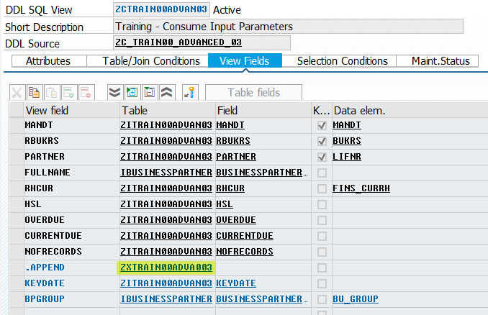
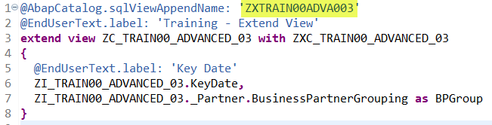
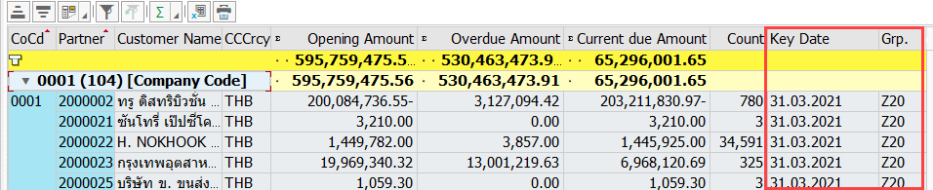
Exercise 16 – Extend View Enhancing an ABAP CDS View
ZXC_TRAINXX_ADVANCED_03
Append ABAP CDS View ‘ZC_TRAINXX_ADVANCED_03’ by ‘ZXC_TRAINXX_ADVANCED_03’
Append SQL View name: ‘ZXTRAINXXADVA003’
Add fields
KEYDATE Display input parameter I_KEYDAT
BPGROUP _PARTNER.BUSINESSPARTNERGROUPING
Run program ‘ZTRAINXX_CDS_04’

Slide 20
SAP Fiori Apps Reference Library

Slide 21
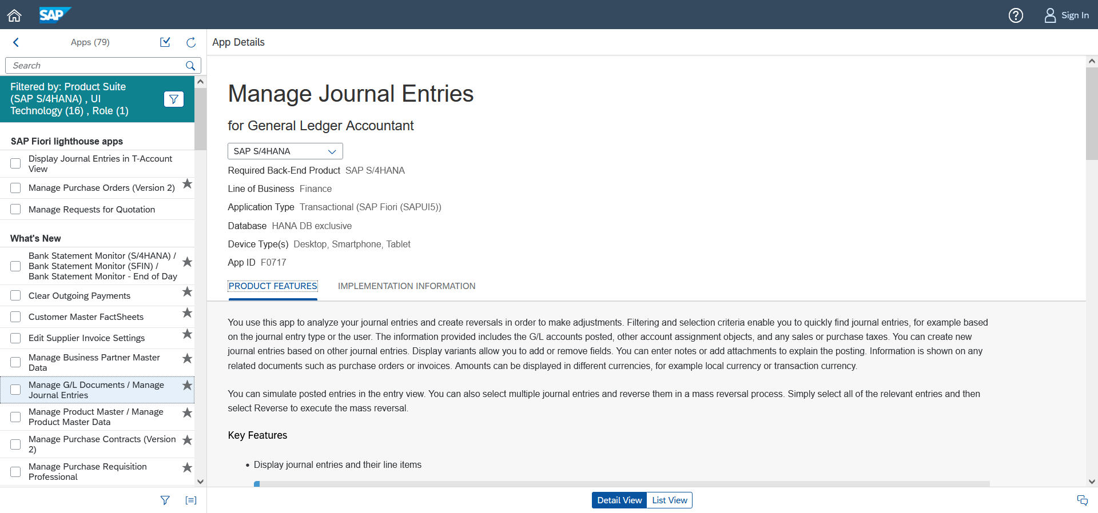
What’s SAP Fiori Apps Reference Library SAP Fiori Apps Reference Library
SAP Fiori Apps Reference Library
List all standard SAP Fiori Apps with the information to implement.
https://fioriappslibrary.hana.ondemand.com/sap/fix/externalViewer/
Notes:
Google “SAP Fiori Library” > 1st result

Slide 22
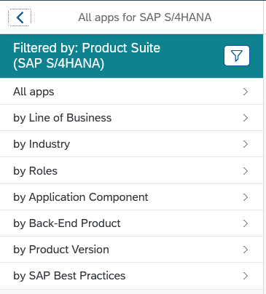
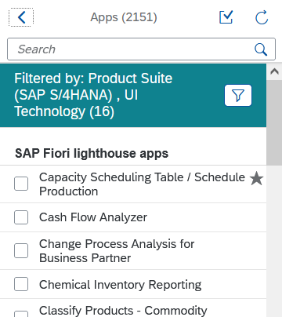
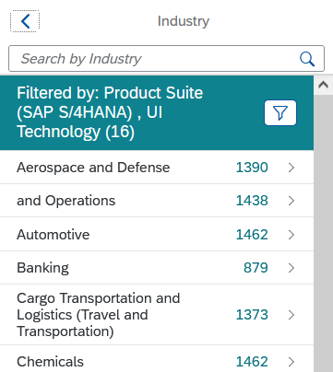
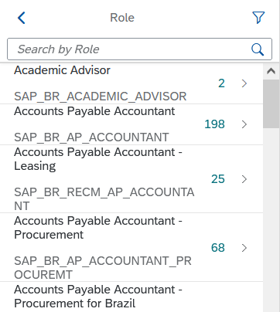
Explore, plan, & implement SAP Fiori Apps Reference Library
Standard SAP Fiori Apps
Explore the available apps by area

Slide 23
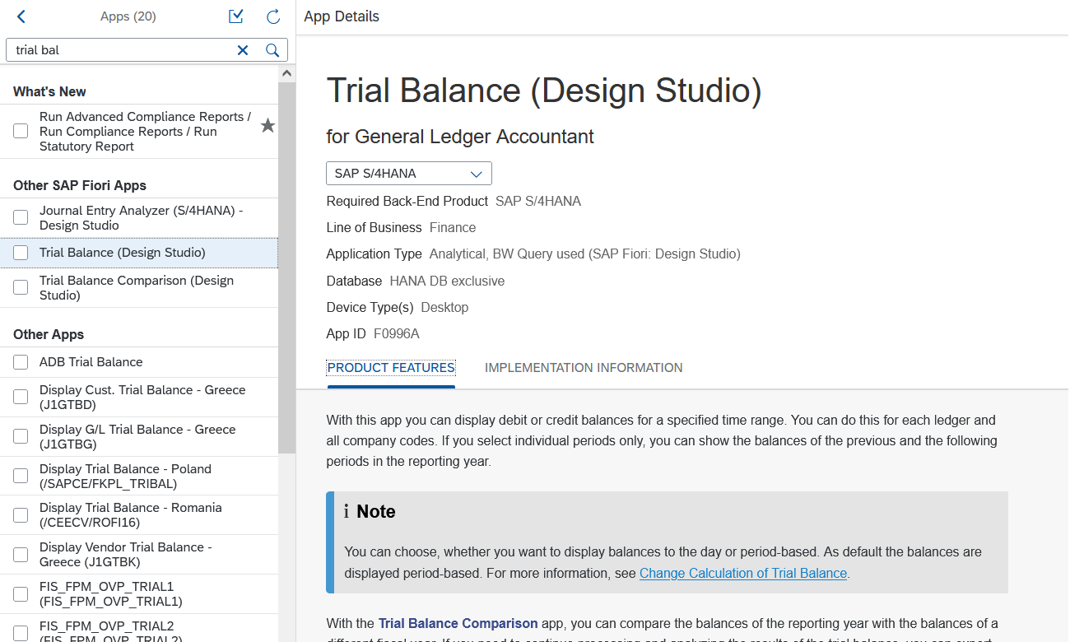
Explore, plan, & implement SAP Fiori Apps Reference Library
Standard SAP Fiori Apps
Search by the Keywords

Slide 24
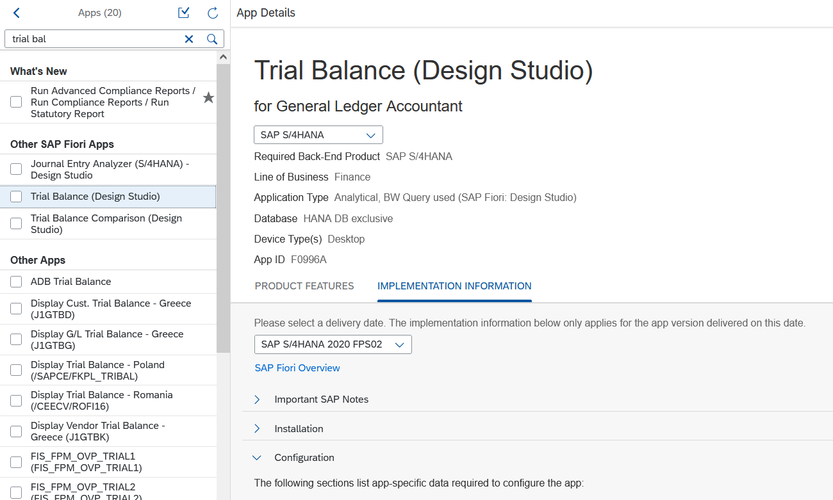
Explore, plan, & implement SAP Fiori Apps Reference Library
Implementation Information
Check your system version is in the list

Slide 25
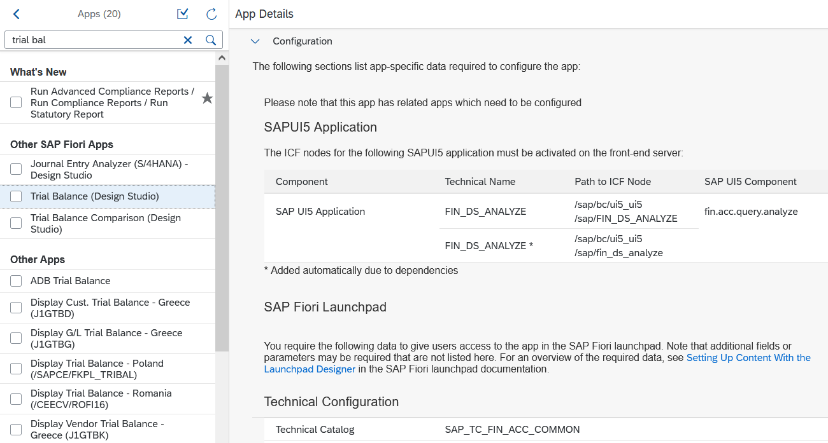
Explore, plan, & implement SAP Fiori Apps Reference Library
Implementation Information - Configuration
Contains technical information of the apps.

Slide 26
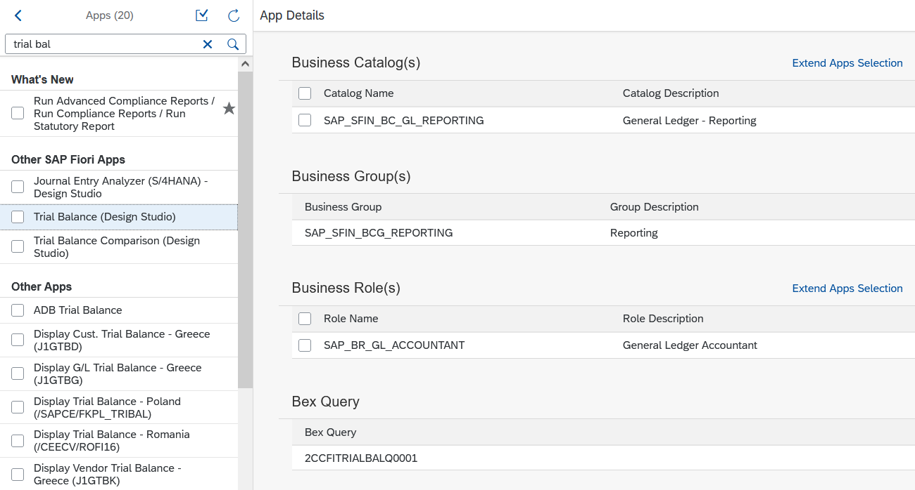
Explore, plan, & implement SAP Fiori Apps Reference Library
Implementation Information - Configuration
Assign authorization with Business Roles

Slide 27
Fiori Launchpad

Slide 28
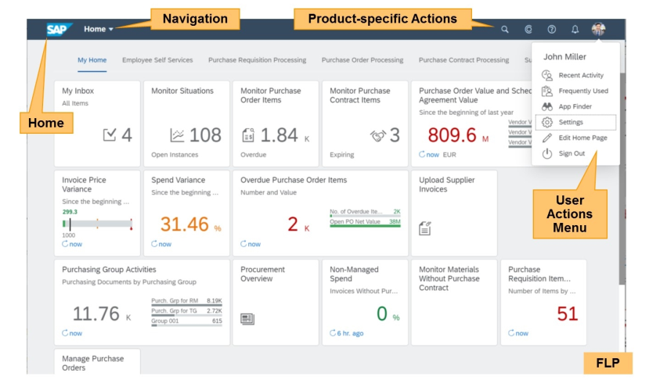
SAP Fiori Launchpad Fiori Launchpad
SAP Fiori Launchpad
1 way to access the Fiori Launchpad is T-Code /UI2/FLP

Slide 29
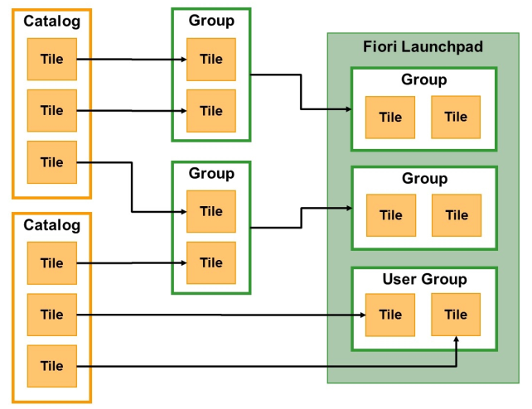
Personalization Fiori Launchpad
Elements of Personalization

Slide 30
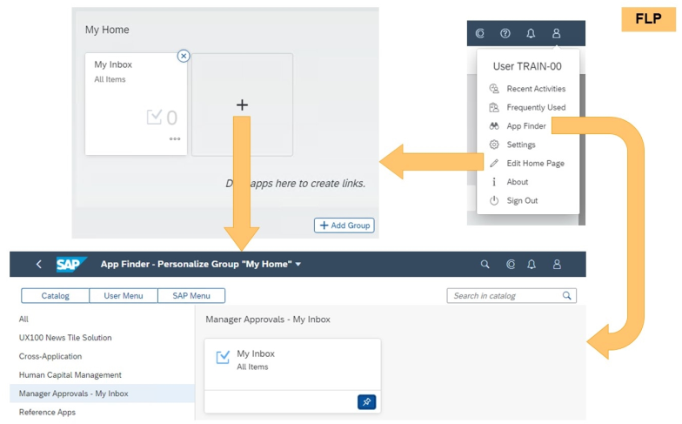
Personalization Fiori Launchpad
Launchpad Personalization

Slide 31
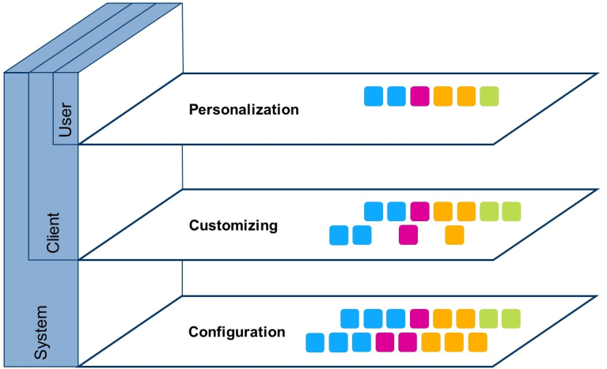
Fiori Launchpad Designer Fiori Launchpad
Layers of Settings
Customizing
https://<HOST>:<PORT>/sap/bc/ui5_ui5/sap/arsrvc_upb_admn/main.html?scope=CUST&sap-client=<CLIENT>
T-Code: /UI2/FLPD_CUST
Configuration
https://<HOST>:<PORT>/sap/bc/ui5_ui5/sap/arsrvc_upb_admn/main.html?scope=CONF&sap-client=<CLIENT>
T-Code: /UI2/FLPD_CONF

Slide 32
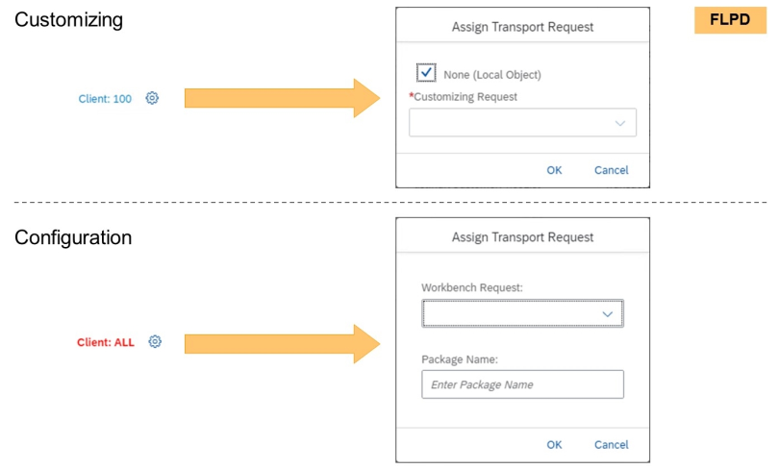
Fiori Launchpad Designer Fiori Launchpad
Layers of Settings
Customizing
Transport Request: Customizing (Client specific)
Configuration
Transport Request: Workbench (Cross Clients)
Package Name

Slide 33
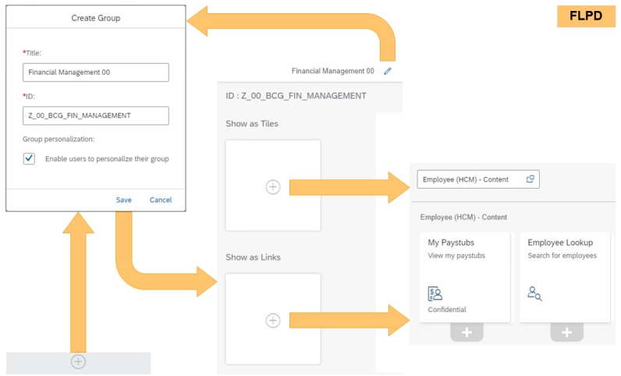
Fiori Launchpad Designer Fiori Launchpad
Tile Group & Role Maintenance

Slide 34
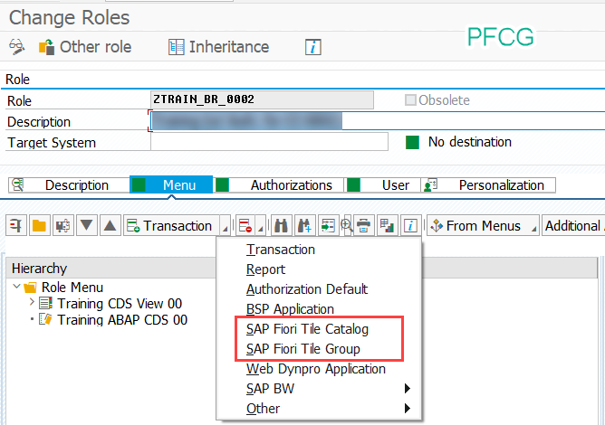
Fiori Launchpad Designer Fiori Launchpad
Tile Group & Role Maintenance
T-Code: PFCG

Slide 35
Exercise 17 – Assign “View Browser” apps Fiori Launchpad
Exercise 17 – Assign “View Browser” apps
Go to SAP Fiori Apps Reference Library
https://fioriappslibrary.hana.ondemand.com/sap/fix/externalViewer/
Or Google “Fiori Library”
Select All apps for SAP S/4HANA > All Apps
Enter “View Browser” in Search box
Select “View Browser” > Implementation Information
Go to section Configurations > Business Catalog

Slide 36
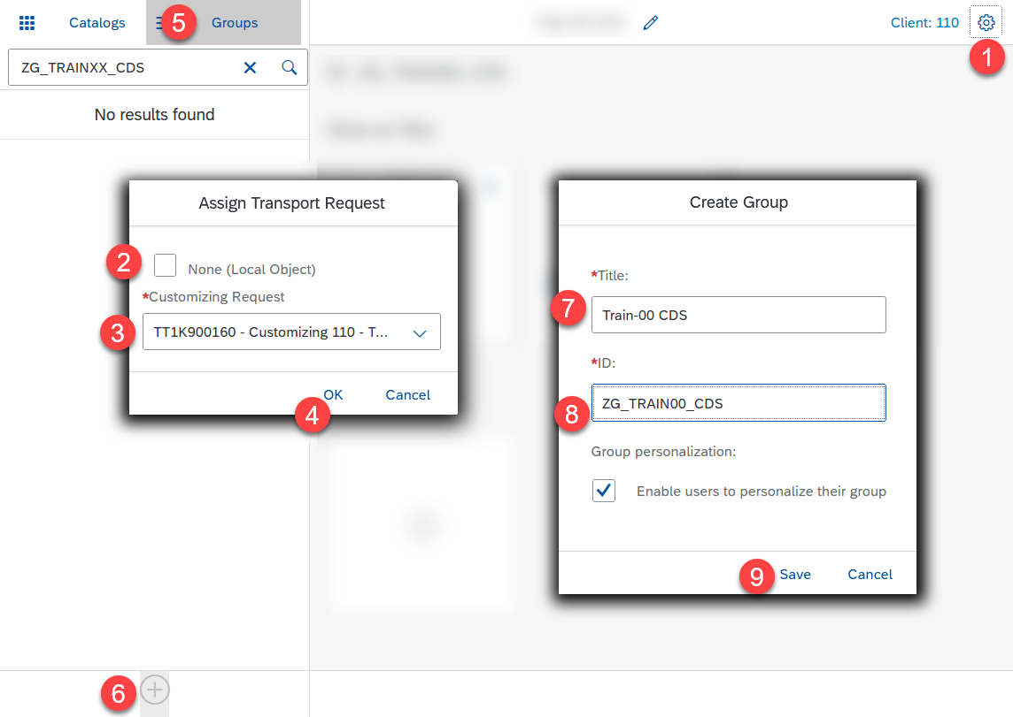
Exercise 17 – Assign “View Browser” apps Fiori Launchpad
Create Tile Group
Run T-Code /UI2/FLPD_CUST in the Test Client (110)
Click Settings icon
Uncheck None (Local Object)
Choose Customizing Transport Request
Click OK
Click Groups > Create Group icon
Enter
Title: Train-XX CDS
ID: ZG_TRAINXX_CDS
Click Save

Slide 37
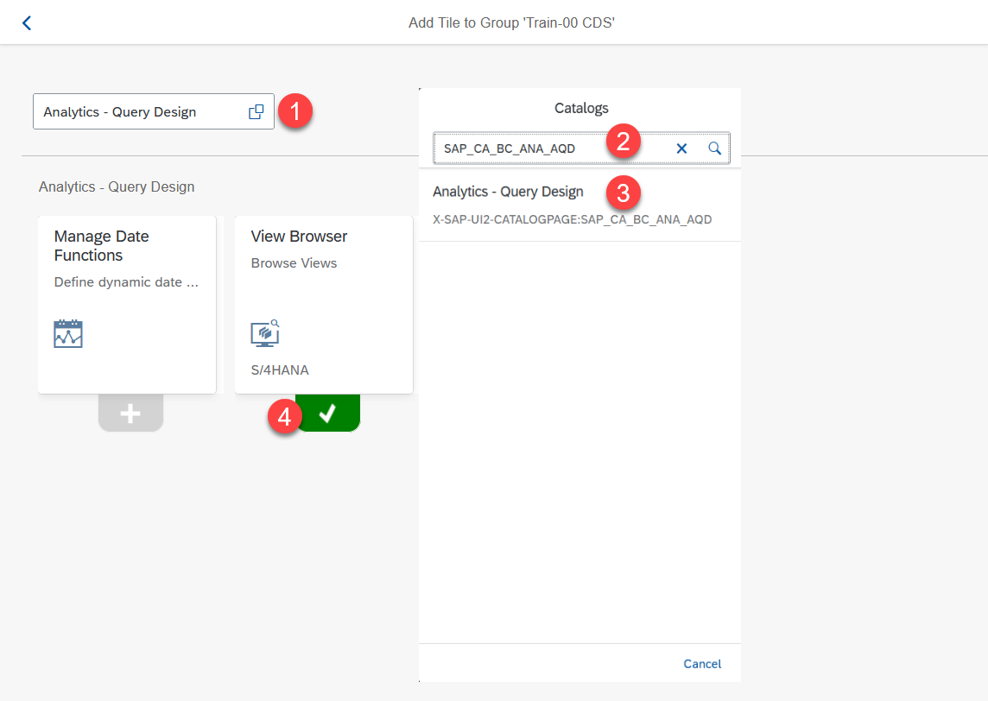
Exercise 17 – Assign “View Browser” apps Fiori Launchpad
Create Tile Group
Click Search Help
Enter SAP_CA_BC_ANA_AQD (from the SAP Fiori Reference Library)
Select the item Analytics – Query Design
Add View Browser apps

Slide 38
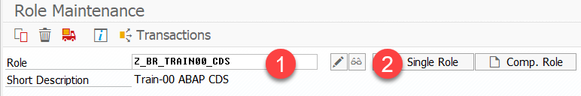
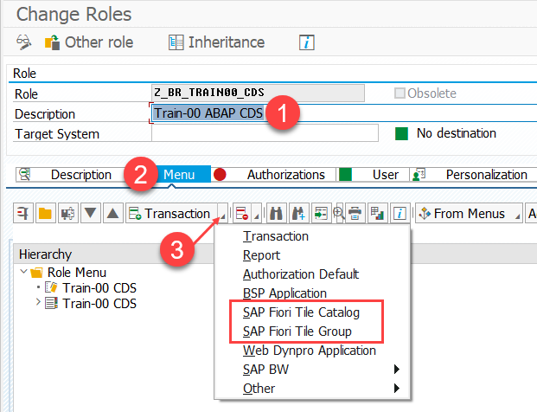
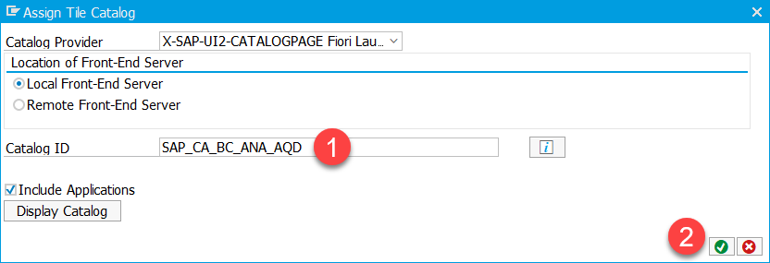
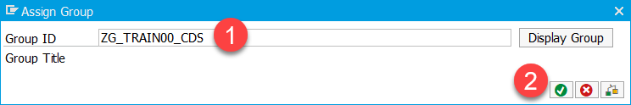
Exercise 17 – Assign “View Browser” apps Fiori Launchpad
Role Maintenance
Run T-Code PFCG in the Test Client (110)
Enter Role Z_BR_TRAINXX_CDS > Single Role
Enter Description
Click Menu > Insert node (step 3)
SAP Fiori Tile Catalog
Enter SAP_CA_BC_ANA_AQD
SAP Fiori Tile Group
Enter ZG_TRAINXX_CDS
Click Save

Slide 39
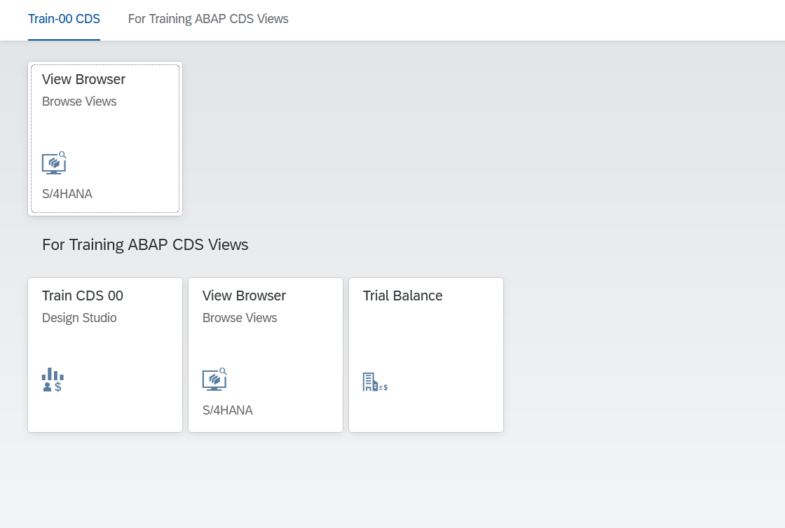

Exercise 17 – Assign “View Browser” apps Fiori Launchpad
Preview Fiori Launchpad
Run T-Code /UI2/FLP in the Test Client (110)

Slide 40
Consumption of ABAP CDS Views (part 2) – Design Studio

Slide 41
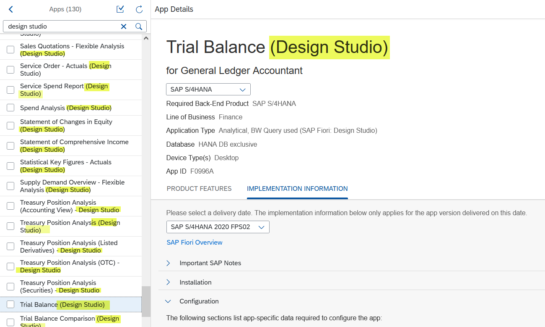

Design Studio Consumption of ABAP CDS Views (part 2) - Design Studio
What is Design Studio?
You may see the title of the Apps ended by (Design Studio)
Like T-Code RSRT

Slide 42
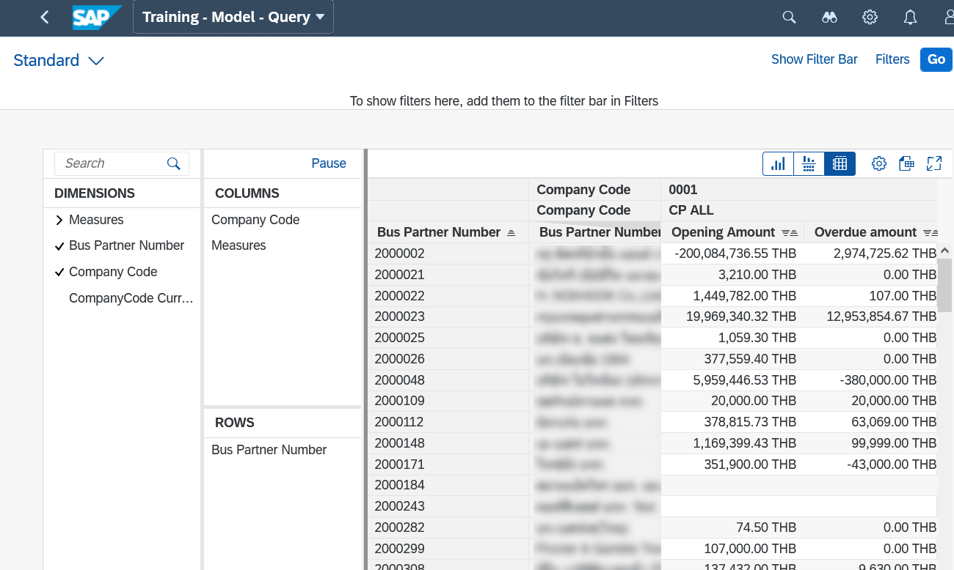
Design Studio Consumption of ABAP CDS Views (part 2) - Design Studio
What is Design Studio?
SAP Fiori apps based on the Design Studio framework.
Flexible environment for adjusting the query using Multidimensional Reporting.

Slide 43
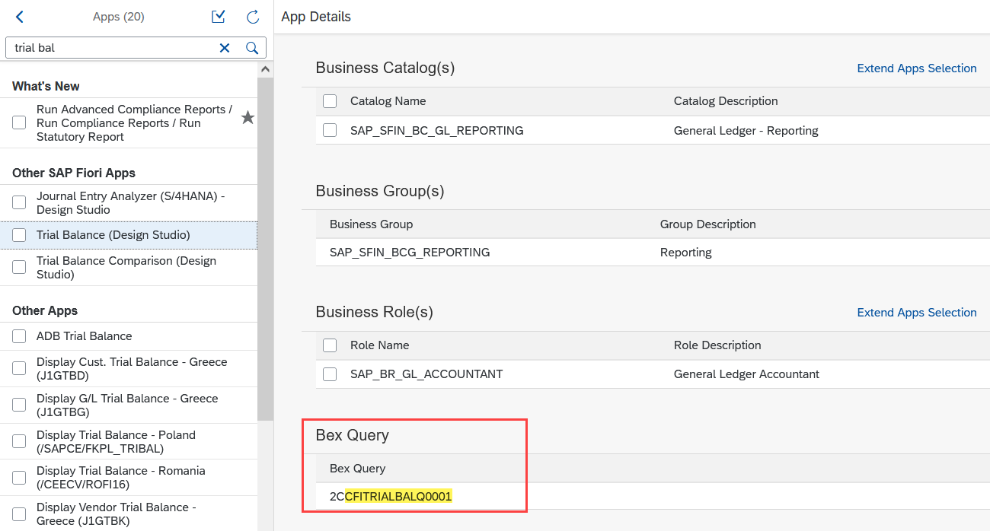
Design Studio Consumption of ABAP CDS Views (part 2) - Design Studio
How is it related to ABAP CDS View?
Go to Implementation Information tab > section Bex Query.
You will see the SQL View name of the ABAP CDS View after the prefix 2C.

Slide 44
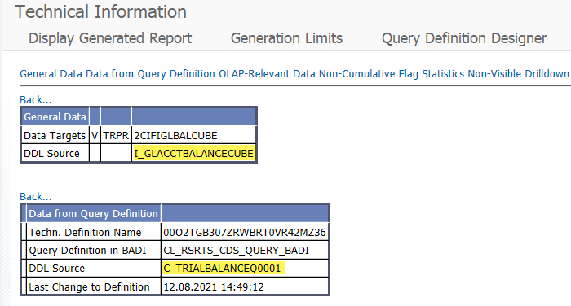
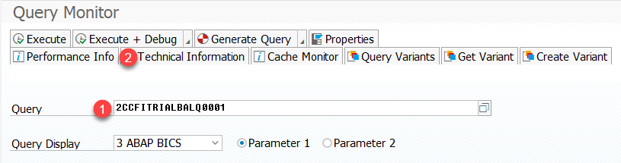
Design Studio Consumption of ABAP CDS Views (part 2) - Design Studio
Link to ABAP CDS View
Go to T-Code RSRT > Enter Query name > Click Technical Information
In the General Data section
DDL Source of the Cube
In the Data from Query Definition section
DDL Source of the Query

Slide 45

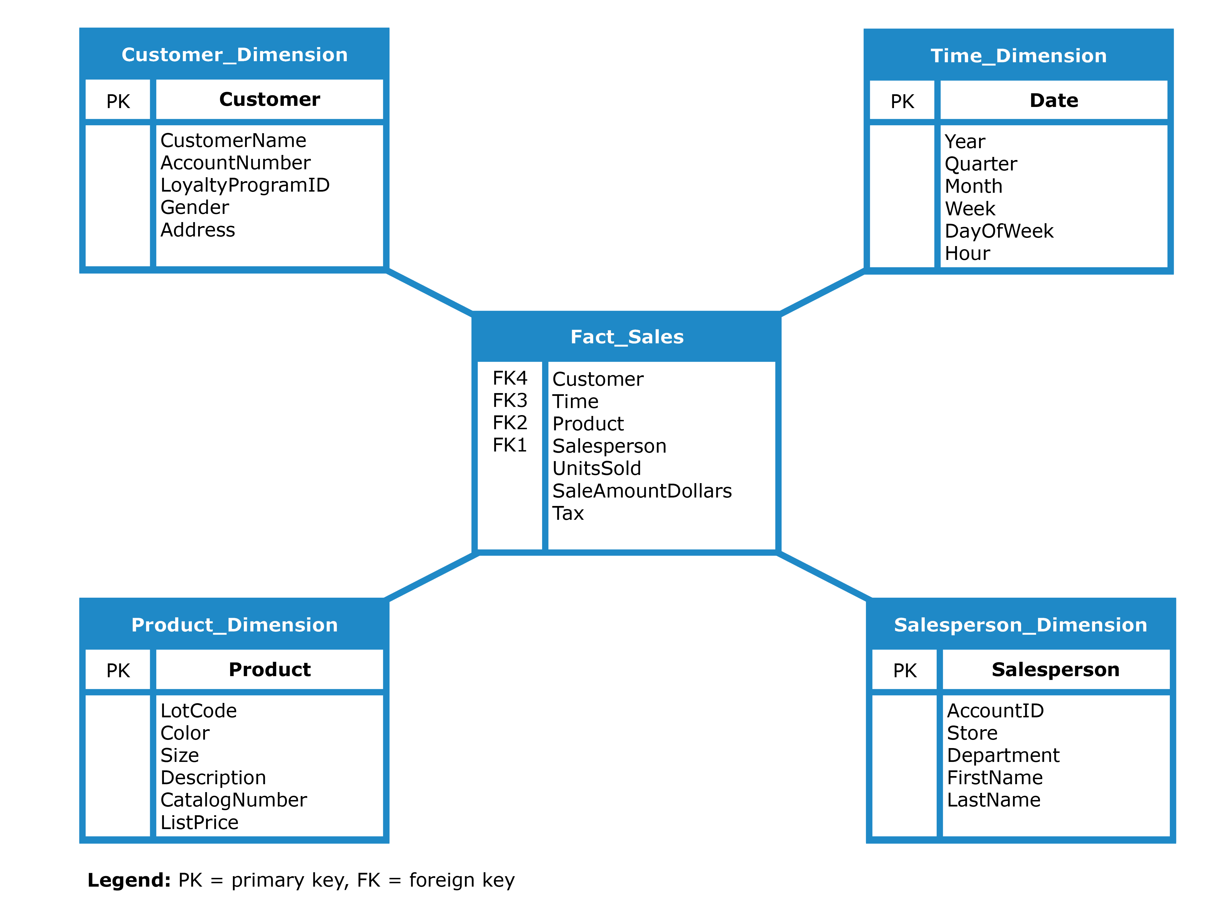
Analytical Models Consumption of ABAP CDS Views (part 2) - Design Studio
Analytical Models
Use advantage of aggregations to expose results across different areas.
The model are formed by Dimensions and Facts and called it Cubes.
Must have at least 1 measure
Dimensions – Master data
Contains attributes
E.g.,
by Company Code
by Customers
by Country
by Age
Facts – transactions
Contains measure/key figures
E.g.,
quantity of Sales Volume
number of People
amount of Open Items

Slide 46



Analytical Models Consumption of ABAP CDS Views (part 2) - Design Studio
Comparing to Classical Report
Write multiple source code for each dimensions
Example: Sales Report by Branch
Dimensions
Business Place
Customer
G/L Account
Measures
Net value
VAT amount
Freight
Total amount

Slide 47
Cubes Consumption of ABAP CDS Views (part 2) - Design Studio
Annotations for Cubes
View annotations
@Analytics.dataCategory: [#VALUE]
#CUBE
#AGGREGATIONLEVEL
#DIMENSION
#FACT
Element annotations
@DefaultAggregation: [#VALUE] or @Aggregation.default: [#VALUE]
#SUM
#AVG
#COUNT
#COUNT_DISTINCT
#FORMULA
#MAX
#MIN
#NONE

Slide 48

Exercise 18 – Cubes Consumption of ABAP CDS Views (part 2) - Design Studio
Exercise 18 – Cubes
Modify ABAP CDS View ‘ZP_TRAINXX_ADVANCED_03’
Add view annotations
@Analytics.dataCategory: #CUBE
Add element annotations
@Aggregation.default: #SUM
HSL
OVERDUE
CURRENTDUE
CAST fields
HSL ZTRAIN_DE_OPENNING
OVERDUE ZTRAIN_DE_OVERDUE
CURRENTDUE ZTRAIN_DE_CURRENTDUE

Slide 49

Exercise 18 – Cubes Consumption of ABAP CDS Views (part 2) - Design Studio
Preview Cubes
Run T-Code RSRTS_ODP_DIS
Enter ‘2CZPTRAINXXADVAN03’ > Execute > Standard Query
Enter parameters
I_KOART ‘D’
I_KEY_DATE 31.03.2021
I_DAYS_1 30

Slide 50
Exercise 18 – Cubes Consumption of ABAP CDS Views (part 2) - Design Studio
Exercise 18 – Aggregation Level
Modify ABAP CDS View ‘ZI_TRAINXX_ADVANCED_03’
Add view annotations
@Analytics.dataCategory: #AGGREGATIONLEVEL
Add element annotations
@Aggregation.default: #SUM
HSL
OVERDUE
CURRENTDUE
CAST fields
HSL ZTRAIN_DE_OPENNING
OVERDUE ZTRAIN_DE_OVERDUE
CURRENTDUE ZTRAIN_DE_CURRENTDUE

Slide 51

Exercise 18 – Cubes Consumption of ABAP CDS Views (part 2) - Design Studio
Preview Cubes
Run T-Code RSRTS_ODP_DIS
Enter ‘2CZITRAINXXADVAN03’ > Execute > Standard Query
Enter parameters
I_KOART ‘D’
I_KEY_DATE 31.03.2021
I_DAYS_1 30

Slide 52
Query Consumption of ABAP CDS Views (part 2) - Design Studio
Query
On top of the Cube.
Must be constructed in a way it can be reused and consumed by several different Queries.
E.g.,
Sales by year quarter
Sales by products with cost above $100
Sales by customer located in a specific city
Average of sales amount per number of sales;

Slide 53
Query Consumption of ABAP CDS Views (part 2) - Design Studio
Annotations for Query
View annotations
@Analytics.query: true
Element annotations
@AnalyticsDetails
@AnalyticsDetails.query.axis: [#VALUE]
#COLUMNS
#FREE
#ROWS
@AnalyticsDetails.query.display: [#VALUE]
#KEY
#KEY_TEXT
#TEXT
#TEXT_KEY
@Consumption
@Consumption.filter.mandatory: true

Slide 54

Exercise 19 – Query Consumption of ABAP CDS Views (part 2) - Design Studio
Exercise 19 – Query
Modify ABAP CDS View ‘ZC_TRAINXX_ADVANCED_03’
Add view annotations
@Analytics.query: true
Add element annotations
@AnalyticsDetails.query.axis: #COLUMNS
RBUKRS
@AnalyticsDetails.query.axis: #ROWS
PARTNER
@Consumption.filter.mandatory: true
RBUKRS

Slide 55

Exercise 19 – Query Consumption of ABAP CDS Views (part 2) - Design Studio
Preview Query
Run T-Code RSRT
Enter ‘2CZCTRAINXXADVAN03’ > Execute
Enter parameters
I_KOART ‘D’
I_KEY_DATE 31.03.2021
I_DAYS_1 30
Company Code ‘0001’ – ‘0004’

Slide 56


Design Studio Consumption of ABAP CDS Views (part 2) - Design Studio
View Browser
List of all available CDS views and their artifacts, such as Category, View Types, Dimensions and Measures, and Annotations.`

Slide 57

Design Studio Consumption of ABAP CDS Views (part 2) - Design Studio
View Details
If the view contains an annotation @Analytics.query: true, then the Button “Show Content” will be appeared.

Slide 58

Design Studio Consumption of ABAP CDS Views (part 2) - Design Studio
Design Studio
After clicked the button “Show Content”, the Design Studio app will generate the analytical report by consuming the selected ABAP CDS View.

Slide 59
Exercise 20 – View Browser Consumption of ABAP CDS Views (part 2) - Design Studio
Exercise 20 – View Browser
Run T-Code /UI2/FLP in the Test Client (110)
Select group Query Design > tile View Browser
Enter TRAINXX at search box
Select tab Consumption > select ABAP CDS View ‘ZC_TRAINXX_ADVANCED_03’
Explore the View Details
Select Show Content at the top-right corner
Enter parameters
I_KOART ‘D’
I_KEY_DATE 31.03.2021
I_DAYS_1 30
Company Code ‘0001’ – ‘0004’

Slide 60


Exercise 20 – View Browser Consumption of ABAP CDS Views (part 2) - Design Studio
View Browser
Select group Query Design > tile View Browser
Enter TRAINXX at search box
Select tab Consumption > select ABAP CDS View ‘ZC_TRAINXX_ADVANCED_03’

Slide 61


Exercise 20 – View Browser Consumption of ABAP CDS Views (part 2) - Design Studio
View Details
Select Show Content at the top-right corner

Slide 62

Exercise 20 – View Browser Consumption of ABAP CDS Views (part 2) - Design Studio
Design Studio
Explore your data

Slide 63


Texts Consumption of ABAP CDS Views (part 2) - Design Studio
Texts/Descriptions of the dimensions
Do not project the text fields in the cube.
Use the feature of Association as a Foreign Key.

Slide 64


Texts Consumption of ABAP CDS Views (part 2) - Design Studio
Annotations for Texts
Element Annotations
Dimensions
@ObjectModel.text.element: [‘TEXTFIELD’]
At the key field. E.g., T001-BUKRS (Company Code)
@Semantics.text: true
At the text field. E.g., T001-BUTXT (Company Name)
Cubes
@ObjectModel.foreignKey.association: ‘_ASSOCIATION’
At the value field. E.g., ACDOCA-RBUKRS (Company Code)

Slide 65


Exercise 21 – Texts Consumption of ABAP CDS Views (part 2) - Design Studio
Exercise 21 – Texts
Modify the Cube ABAP CDS View ‘ZP_TRAINXX_ADVANCED_03’
Add Foreign Key Association to dimensions
Element annotations
PARTNER
@ObjectModel.foreignKey.association: '_Partner'

Slide 66

Exercise 21 – Texts Consumption of ABAP CDS Views (part 2) - Design Studio
Preview
Open View Browser apps for ‘ZC_TRAINXX_ADVANCED_03’ or refresh the opening report of Exercise 19
Right-click at Business Partner > Display > Key and Text

Slide 67

Exercise 21 – Texts Consumption of ABAP CDS Views (part 2) - Design Studio
Link more Dimensions
Modify ABAP CDS View ‘ZP_TRAINXX_ADVANCED_03’
Add relations to
ZI_TrainXX_Basic_01 as _Company
BUKRS = field $PROJECTION.RBUKRS
Expose annotations
_Company
Element annotations
RBUKRS
@ObjectModel.foreignKey.association: '_Company’

Slide 68


Exercise 21 – Texts Consumption of ABAP CDS Views (part 2) - Design Studio
Modify Dimensions and Preview
Modify ABAP CDS View ‘ZI_TRAINXX_BASIC_01’ (Dimension: Company)
Element annotations
BUKRS
@ObjectModel.text.element: ['BUTXT’]
BUTXT
@Semantics.text: true
Preview
Open View Browser apps for ‘ZC_TRAINXX_ADVANCED_03’

Slide 69
Formula Consumption of ABAP CDS Views (part 2) - Design Studio
What is Formula?
Sometimes the default aggregations(SUM, MIN, MAX, …) do not suit with the purpose of the measures.
For example:
Percentage
Same issue as the subtotal in the ALV Report.
The percentage cannot be sum up. But must calculate by each row.

Slide 70
Formula Consumption of ABAP CDS Views (part 2) - Design Studio
Annotations for Formula
Available only for the Consumption View contains annotation @Analytics.query: true
Create empty fields in the ABAP CDS View with Type Conversion.
Element annotations:
@AnalyticsDetails.query.formula: ‘FORMULA’
Cube measures and/or other numeric elements of the element list.
Arithmetic expressions using operators + - * /
Functions NDIV0, NODIM, SQRT, SUMGT, SUMCT and SUMRT, which represent the corresponding BW formula functions
CASE expressions (CASE WHEN THEN ELSE)
Example:
E.g., Overdue * 100 / Open (percentage)
@AnalyticsDetails.query.formula: ‘NDIV0( Overdue * 100 / Open )’ CAST( 0 as ABAP.DEC(23,2) ) as PERCENTOVER

Slide 71

Exercise 22 – Formula Consumption of ABAP CDS Views (part 2) - Design Studio
Exercise 22 – Formula
Modify the Query ABAP CDS View ‘ZC_TRAINXX_ADVANCED_03’
Add fields
PERCENTOVERDUE Calculate % of Overdue over Opening amount
Element annotations
PERCENTOVERDUE
@AnalyticsDetails.query.axis: #COLUMNS
@AnalyticsDetails.query.formula: 'NDIV0( OVERDUE * 100 / OPENINGAMOUNT)’
@EndUserText.label: '%Overdue'

Slide 72

Exercise 22 – Formula Consumption of ABAP CDS Views (part 2) - Design Studio
Preview
Open View Browser apps for ‘ZC_TRAINXX_ADVANCED_03’

Slide 73
Fiori Launchpad Configurations

Slide 74

Configurations Fiori Launchpad Configurations
Managing SAP Fiori Catalogs
The Tile navigate to the Application by an intent that connects to a target mapping.
Tile Catalog
Tile/Link
Target Mapping
Tile Group
Tile/Link from multiple catalogs
User Role (PFCG)
Tile Catalogs
Tile Groups
Notes:
Application:
SAP UI5
Transaction Code
Web Dynpro

Slide 75

Configurations Fiori Launchpad Configurations
Intent-Based Navigation
https://<HOST>:<PORT>/sap/bc/ui2/flp#<SemanticObject>-<Action>
E.g.,
#SalesOrder-display
Link to T-Code VA03
#SalesOrder-create
Link to T0Code VA01
Notes:
Application:
SAP UI5
Transaction Code
Web Dynpro

Slide 76

Configurations Fiori Launchpad Configurations
Target Mapping
Application Type
SAP UI5 Application
Transaction Code
Web Dynpro
URL
Notes:
Application:
SAP UI5
Transaction Code
Web Dynpro

Slide 77

Configurations Fiori Launchpad Configurations
Configuration steps

Slide 78

Configurations Fiori Launchpad Configurations
Semantic Object
Represents a business entity.
E.g.,
A customer
A sales order
T-Code
/UI2/SEMOBJ_SAP
A list of all semantic objects delivered by SAP.
/UI2/SEMOBJ
Define our own semantic objects.

Slide 79

Exercise 23 – Tile Consumption of ABAP CDS Views (part 2) - Design Studio
Create Tile Catalog
Run T-Code /UI2/FLPD_CUST in the Test Client (110)
Click Settings icon
Uncheck None (Local Object)
Choose Customizing Transport Request
Click OK
Click Catalogs > Create Catalog icon
Enter
Title: Train-XX CDS
ID: ZF_TRAINXX_CDS
Click Save

Slide 80



Exercise 23 – Tile Consumption of ABAP CDS Views (part 2) - Design Studio
Create Tile
Click Add Tile icon
Click App Launcher – Static
Enter
General
Title: Train CDS XX – ALV IDA
Subtitle: ALV IDA
Navigation
Semantic Object: ZTRAIN_ABAP_CDS
Action: ALVIDAXX
Click Save

Slide 81


Exercise 23 – Tile Consumption of ABAP CDS Views (part 2) - Design Studio
Create Target Mapping
Click Target Mapping icon
Click Create Target Mapping
Enter
Intent
Semantic Object: ZTRAIN_ABAP_CDS
Action: ALVIDAXX
Target
Application Type: Transaction
Title: Train CDS XX – ALV IDA
Transaction: ZTRAIN00_CDS_04
System Alias: S4FIN
Click Save

Slide 82

Exercise 23 – Tile Consumption of ABAP CDS Views (part 2) - Design Studio
Add Tile to Group
Click Groups tab
Enter ZG_TRAINXX_CDS
Click Add Tile icon
Click Search Help
Enter ZF_TRAINXX_CDS
Select the item Train-XX CDS
Add Train CDS XX - ALV IDA apps

Slide 83



Exercise 23 – Tile Consumption of ABAP CDS Views (part 2) - Design Studio
Preview
Run T-Code /UI2/FLP or refresh the opening launchpad
Click Train CDS XX – ALV IDA

Slide 84

Exercise 23 – Tile Consumption of ABAP CDS Views (part 2) - Design Studio
Create Tile
Run T-Code /UI2/FLPD_CUST in the Test Client (110)
Click Add Tile icon
Click App Launcher – Static
Enter
General
Title: Train CDS XX – Query
Subtitle: Design Studio
Navigation
Semantic Object: ZTRAIN_ABAP_CDS
Action: QueryXX
Click Save

Slide 85
Exercise 23 – Tile Consumption of ABAP CDS Views (part 2) - Design Studio
Create Target Mapping
Click Target Mapping icon
Click Create Target Mapping
Enter
Intent
Semantic Object: ZTRAIN_ABAP_CDS
Action: QueryXX
Target
Application Type: SAPUI5 Fiori App
Title: Train CDS XX – Query
URL: /sap/bc/ui5_ui5/sap/FIN_DS_ANALYZE
ID: fin.acc.query.analyze
General
Device Type: Desktop
Parameters:
Click Save
Name | Default Value
XQUERY | 2CZCTRAIN00ADVAN03
XSYSTEM | S4FIN

Slide 86
Exercise 23 – Tile Consumption of ABAP CDS Views (part 2) - Design Studio
Add Tile to Group
Click Groups tab
Enter ZG_TRAINXX_CDS
Click Add Tile icon
Click Search Help
Enter ZF_TRAINXX_CDS
Select the item Train-XX CDS
Add Train CDS XX - Query apps

Slide 87
Exercise 23 – Tile Consumption of ABAP CDS Views (part 2) - Design Studio
Preview
Run T-Code /UI2/FLP or refresh the opening launchpad
Click Train CDS XX – ALV IDA

Slide 88


Exercise 23 – Tile Consumption of ABAP CDS Views (part 2) - Design Studio
Preview
Run T-Code /UI2/FLP or refresh the opening launchpad
Click Train CDS XX – ALV IDA

Slide 89
Consumption of ABAP CDS Views (part 3) – OData Services

Slide 90

OData Services Consumption of ABAP CDS Views (part 3) – OData Services
What is OData Service?
OData is a standard Web protocol used for querying and updating data.
Expose your SAP Data (Table or Query Data) to external environment.
Obtain human readable results.
Use stateless applications.
Receive related pieces of information, one leading to another.
Use standard GET, PUT, POST, DELETE, and QUERY.
Notes:
Application:
SAP UI5
Transaction Code
Web Dynpro

Slide 91

OData Services Consumption of ABAP CDS Views (part 3) – OData Services
OData in XML format
Notes:
Application:
SAP UI5
Transaction Code
Web Dynpro

Slide 92

OData Services Consumption of ABAP CDS Views (part 3) – OData Services
OData in JSON format
Notes:
Application:
SAP UI5
Transaction Code
Web Dynpro

Slide 93


OData Services Consumption of ABAP CDS Views (part 3) – OData Services
How to Create OData Service
SAP Gateway Service Builder (T-Code: SEGW)
ABAP CDS Views with annotation @Odata.publish:true
Notes:
Application:
SAP UI5
Transaction Code
Web Dynpro

Slide 94

Exercise 24 – OData Services Consumption of ABAP CDS Views (part 3) – OData Services
Exercise 24 – OData Services
Duplicate ZC_TRAIN00_ADVANCED_03 to ZC_TRAIN00_ADVANCED_04
SQL View name ‘ZCTRAINXXADVAN04’
Remove all the elements/parameters annotations
Fixed parameters of the main data-source
I_KEY_DATE SYSTEM_DATE
I_DAYS_1 30
I_KOART ‘D’’
Add View Annotations
@Odata.publish: true

Slide 95



Exercise 24 – OData Services Consumption of ABAP CDS Views (part 3) – OData Services
Register OData Service
Run T-Code /IWFND/MAINT_SERVICE
Click Add Service
Enter
System Alias LOCAL
Technical Service Name *TRAINXX*
Select ZC_TRAINXX_ADVANCED_04
Click Add Selected Services
Enter
Package ZTRAINXX_CDS
Click Enter
Choose your Workbench Request
Click Back

Slide 96




Exercise 24 – OData Services Consumption of ABAP CDS Views (part 3) – OData Services
Register OData Service
Click Filter > Enter Technical Service Name ‘*TRAINXX*’
Double click ‘ZC_TRAINXX_ADVANCED_04_CDS’
At section System Aliases > Click Customizing
At menu bar Table View > Transport
Choose your Customizing Request
Click Include in Request > Save
Run T-Code SCC1 in the Test Client (110)
Enter your Customizing Request
Mark checkbox Include task in request
Click Start Immediately

Slide 97


Exercise 24 – OData Services Consumption of ABAP CDS Views (part 3) – OData Services
Preview
Run T-Code /IWFND/MAINT_SERVICE in the Test Client (110)
Click Filter > Enter Technical Service Name ‘*TRAINXX*’
Double click ‘ZC_TRAINXX_ADVANCED_04_CDS’
At section ICF Nodes > Click SAP Gateway Client
SAP Gateway Client
Click Execute to see the metadata
Click EntitySets > Choose ZC_TRAINXX_ADVANCED_04
Click Add URI Options > $top=2 > Execute

Slide 98
Consumption of ABAP CDS Views (part 4) – Manage KPIs and Reports

Slide 99

Manage KPIs and Reports Consumption of ABAP CDS Views (part 4) – Manage KPIs and Reports
What is a Manage KPIs and Reports apps?
A single platform for creating all analytical applications using KPIs, and reports.
Create applications that can be launched directly from SAP Fiori launchpad.
Notes:
Application:
SAP UI5
Transaction Code
Web Dynpro

Slide 100
Manage KPIs and Reports Consumption of ABAP CDS Views (part 4) – Manage KPIs and Reports
Features
Groups
You use this section to create groups for multiple KPIs.
Key Performance Indicators (KPIs)
KPIs are used to identify and measure the key metrics of a business.
You create an evaluation to define a specific representation of a KPI, which means that you define a certain selection of the KPI data, the targets and thresholds that are relevant, together with some additional information.
You can then create a KPI that restricts the results to a certain area of that country for which one sales representative is responsible.
You must specify an active group when you're creating a KPI.
Reports
The reports for active KPIs as the starting point for further analysis.
At runtime, you select the application to open either an SAP Smart Business generic drill-down application or a Data Analyzer and Story runtime.
You can choose how to visualize the tile by selecting one of the available tiles (numeric, comparison, trend, or actual vs. target).
Notes:
Application:
SAP UI5
Transaction Code
Web Dynpro

Slide 101




Exercise 25 – Manage KPIs and Reports Consumption of ABAP CDS Views (part 4) – Manage KPIs and Reports
Create a Group
Run T-Code /UI2/FLP
Go to KPI Design group > Click on Manage KPIs and Reports apps.
Click on Profile icon at top-right corner > App Settings
Choose your Transport Requests
Enter package ZTRAINXX_CDS > Click OK
Click Add Group icon

Slide 102


Exercise 25 – Manage KPIs and Reports Consumption of ABAP CDS Views (part 4) – Manage KPIs and Reports
Create a Group
Enter Title
Train XX – Group
Click Save and Activate
Choose your Transport Requests > OK

Slide 103


Exercise 25 – Manage KPIs and Reports Consumption of ABAP CDS Views (part 4) – Manage KPIs and Reports
Create a KPI
Click on KPIs tab > Add KPI icon
Enter Title
Train XX - KPI
Go to Data Source Details > Click on Define

Slide 104

Exercise 25 – Manage KPIs and Reports Consumption of ABAP CDS Views (part 4) – Manage KPIs and Reports
Create a KPI
Search CDS View ‘TRAINXX’
Select ZC_TRAINXX_ADVANCED_04 > Click OK
Notes: Make sure the ABAP CDS View is exposing to the OData service and it got registered.

Slide 105


Exercise 25 – Manage KPIs and Reports Consumption of ABAP CDS Views (part 4) – Manage KPIs and Reports
Create a KPI
Choose Value Measure
Opening Amount
Click Save and Activate
Choose your Transport Request > OK

Slide 106


Exercise 25 – Manage KPIs and Reports Consumption of ABAP CDS Views (part 4) – Manage KPIs and Reports
Create a Report
Click Crate Report > Generic Drilldown
Enter Title
Train XX – Report
Go to Configurations tab
Go to Mini chart
Click Add Mini chart icon
Choose the Dynamic Tile Layout

Slide 107


Exercise 25 – Manage KPIs and Reports Consumption of ABAP CDS Views (part 4) – Manage KPIs and Reports
Create a Report
Go to Charts and Tables
Click Add View icon
Enter Information
View Title: ‘Chart1’
View Type: Chart
Click Add
Click Settings
Add Dimension Business Partner as Category
Click Selected Chart Type > Pie

Slide 108


Exercise 25 – Manage KPIs and Reports Consumption of ABAP CDS Views (part 4) – Manage KPIs and Reports
Create a Report
Go to Charts and Tables
Click Add View icon
Enter Information
View Title: ‘Table1’
View Type: Table
Click Add
Click Settings
Mark checkbox Select All
Arrange the columns > OK
Click Activate

Slide 109


Exercise 25 – Manage KPIs and Reports Consumption of ABAP CDS Views (part 4) – Manage KPIs and Reports
Create a Tile
Go to Application tab
Click Add Tile > Numeric Tile

Slide 110


Exercise 25 – Manage KPIs and Reports Consumption of ABAP CDS Views (part 4) – Manage KPIs and Reports
Create a Tile
Tile Configuration
Title: Train XX – Report
Subtitle: Manage KPIs and Reports
Catalog: Choose ZF_TRAINXX_CDS
Target Mapping
Semantic Obj: ZTRAIN_ABAP_CDS
Action: kpiXX
Click Save

Slide 111

Exercise 25 – Manage KPIs and Reports Consumption of ABAP CDS Views (part 4) – Manage KPIs and Reports
Add Tile to Tile Group
Run T-Code /UI2/FLPD_CUST in the Test Client (110)
Click Groups
Enter ‘TrainXX’
Choose ZG_TRAINXX_CDS
Click Add Tile icon
Browse the Catalog > Enter ‘TrainXX’ > Choose ZF_TRAINXX_CDS
Add TrainXX – KPI apps

Slide 112


Exercise 25 – Manage KPIs and Reports Consumption of ABAP CDS Views (part 4) – Manage KPIs and Reports
Preview
Run T-Code /UI2/FLP in the Test Client (110) or refresh the opening launchpad.
Click Train 00 – Report apps

Slide 113
Virtual Elements for ABAP CDS Views

Slide 114

Virtual Elements Virtual Elements for ABAP CDS Views
What is Virtual Element?
Use when the field cannot easily make calculations with ABAP CDS Views.
E.g., Long texts from FM ‘READ_TEXT’
Elements Annotations
@ObjectModel.virtualElement: true
@ObjectModel.virtualElementCalculatedBy: ‘<ABAP_CLASS>'
Create the temporary fields with the reference to the ABAP Class.
Implement Interfaces
IF_SADL_EXIT_CALC_ELEMENT_READ
IF_SADL_EXIT_FILTER_TRANSFORM
IF_SADL_EXIT_SORT_TRANSFORM

Slide 115



Virtual Elements Virtual Elements for ABAP CDS Views
Virtual Elements Implementations
Class Implementations
ABAP CDS Views with Virtual Elements
Class Definitions

Slide 116



Virtual Elements Virtual Elements for ABAP CDS Views
Preview
T-Code ME23N
Fiori – My Inbox – Release Purchase Order
OData Service

